Slide 1
Analysis on Brazil Housing Data
UNDER THE GUIDANCE OF Gaurav MISHRA SIR
BY
` SHAIK AAYESHA MOHAMMADI

Slide 2
TABLE OF CONTENTS
INTRODUCTION
DATA OVERVIEW
EXPLORATORY DATA ANALYSIS (EDA)
HYPOTHESES
ANALYSIS OF HYPOTHESES
INSIGHTS
ADVANTAGES AND DISADVANTAGES
APPLICATIONS
CONCLUSION

Slide 3
1) INTRODUCTION
Problem Statement: The rise of remote work, accelerated by the global shift in work culture due to the COVID-19 pandemic, has prompted individuals and families in expensive Brazilian cities like Rio de Janeiro and São Paulo to consider relocating to more affordable cities while continuing to work remotely.
Context: Castro Brazila Inc., a leading real estate management firm in Brazil, recognizes this shifting landscape and aims to assist people in making informed decisions about relocating to alternative cities that offer affordability, quality of life, and remote work opportunities.
Need of the Study: This study addresses the evolving needs and preferences of those considering relocation in the context of remote work. By providing comprehensive information and analysis, it empowers individuals and families to make well-informed decisions about where to live and work, enhancing their quality of life and financial well-being.
Business Objective: In light of the high cost of living in cities like Rio De Janeiro and São Paulo, the objective is to provide affordable and suitable relocation options. The aim is to help individuals find furnished houses at a reasonable cost in cities like Porto Alegre and Campinas, which offer more affordable living options compared to Rio De Janeiro and São Paulo.

Slide 4
2)DATA OVERVIEW
Dataset Description: The dataset comprises credit-related data with 10692 rows and 13 columns, with no missing values.
Data Size and Missing Values: The dataset contains 10692 rows and 13 columns. Some columns no missing values.

Slide 5
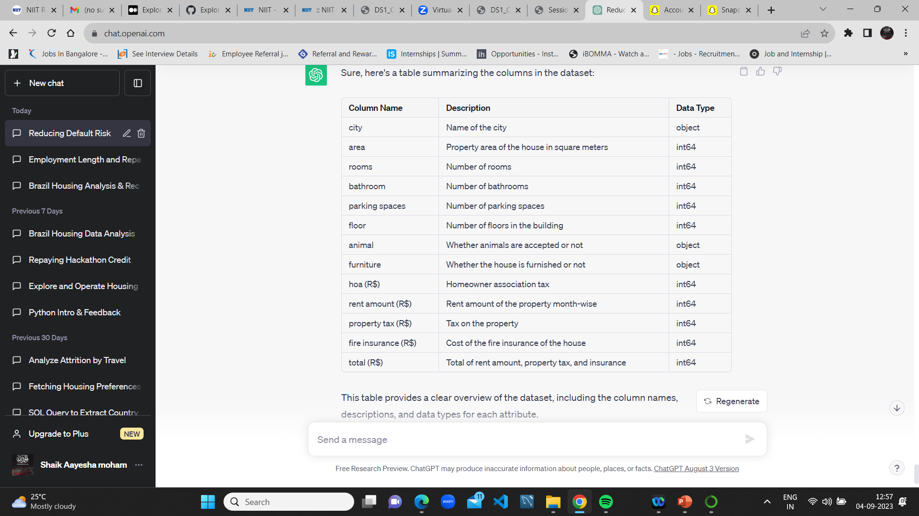
Dataset Columns and Description
This table provides a clear overview of the dataset, including the column names, descriptions, and data types for each attribute.

Slide 6
3.EXPLORATORY DATA ANALYSIS (EDA)
Exploratory Data Analysis (EDA) is a crucial step in the data analysis process. It involves examining and summarizing the main characteristics of a dataset to uncover initial insights and patterns.
Data Distribution Analysis:
EDA begins by analyzing the distribution of key variables in the dataset to understand the data's central tendencies and variability.

Slide 7
4.HYPOTHESES
Which City has the Highest and Lowest Monthly Rent Amount?
Does having animals impact the Rent?
Will furnished houses have a higher rental value?
What is the Average Rent by City?
What is the Average HOA (Homeowners Association Tax) by City?
Do the count of bathrooms impact the average rent amount city-wise?
Do the count of rooms impact the average rent amount city-wise?
How does the average fire insurance impact the rent amount city-wise?
How does the average property tax impact the rent amount city-wise?
City-wise count of rooms by floors in the building.
Does the number of parking spaces impact the rental value?
Does the Area impact the rental value?
Which City is Suitable for Bachelors by Average Rent?
Which City is Suitable for mid-Sized Familes by Average Rent?
Which City is Suitable for Large-Sized Familes by Average Rent?

Slide 8
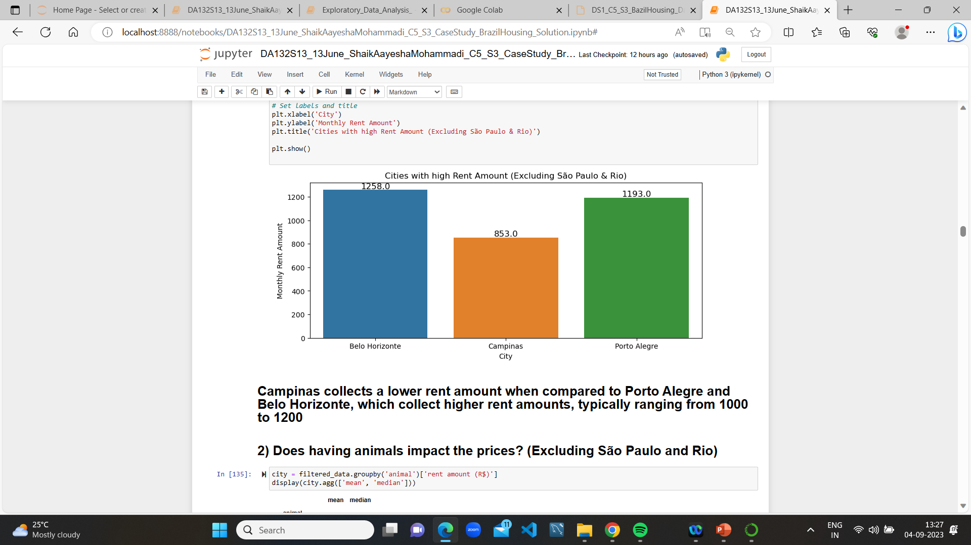
1)Which City has the Highest and Lowest Monthly Rent Amount?
Campinas collects a lower rent amount when compared to Porto Alegre and Belo Horizonte, which collect higher rent amounts, typically ranging from 1000 to 1200

Slide 9
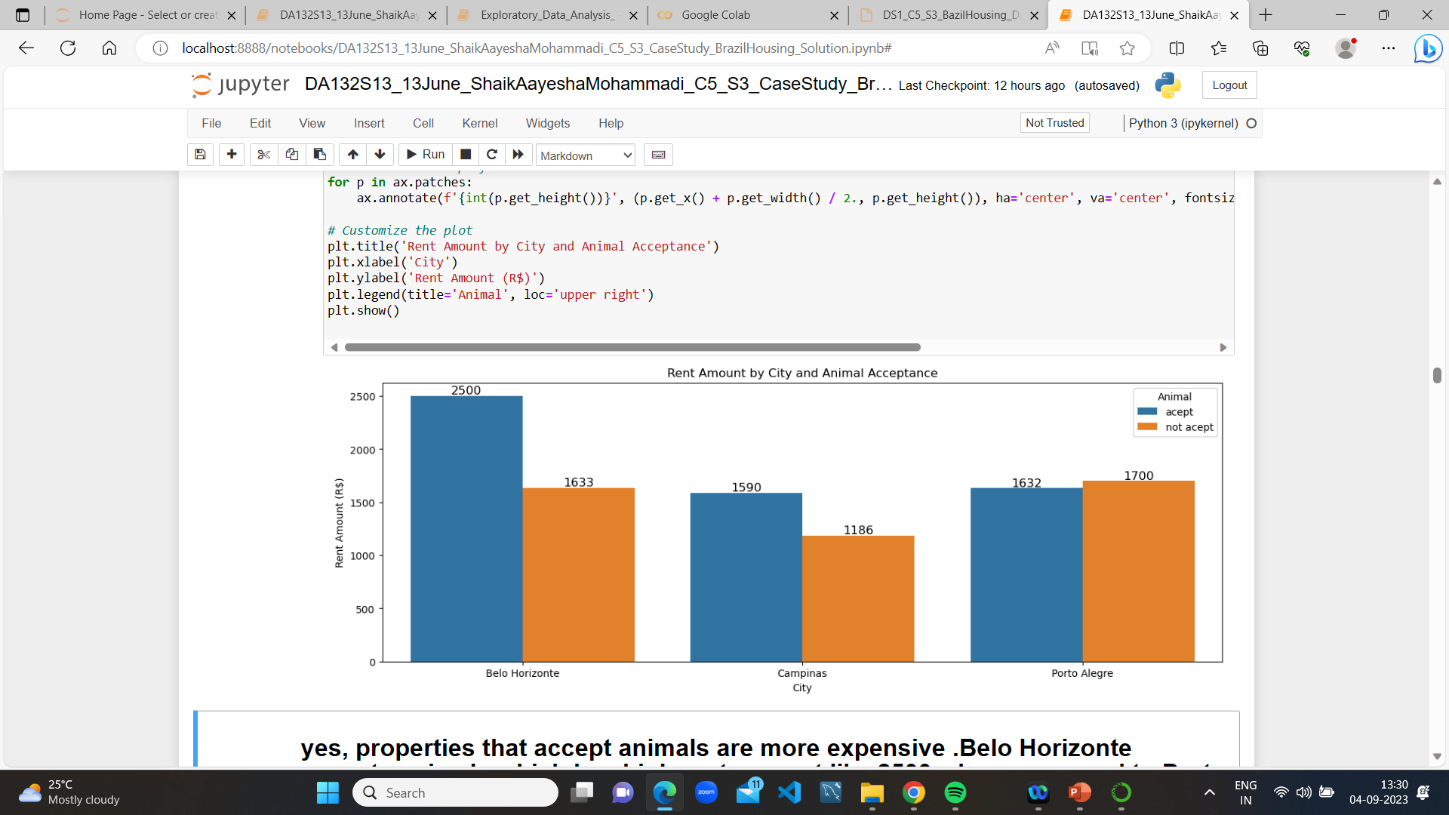
2)Does having animals impact the Rent?
yes, properties that accept animals are more expensive .Belo Horizonte accepts animals which has high rent amount like 2500 when compared to Porto Alegre and campinas.

Slide 10
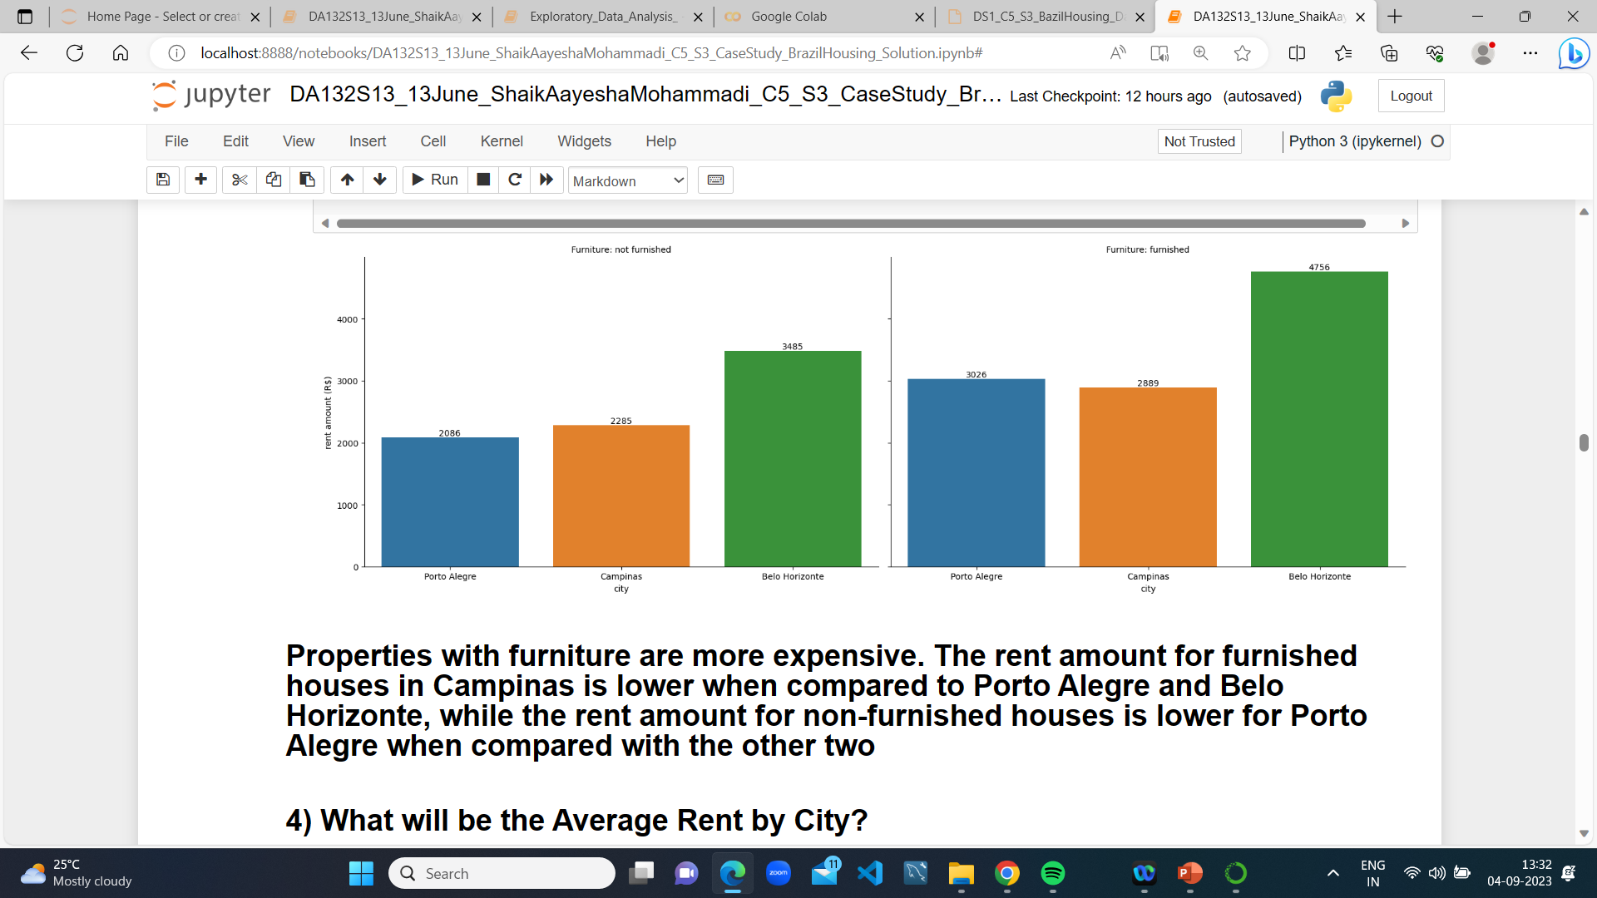
3) Will furnished houses have a higher rental value?
Properties with furniture are more expensive. The rent amount for furnished houses in Campinas is lower when compared to Porto Alegre and Belo Horizonte, while the rent amount for non-furnished houses is lower for Porto Alegre when compared with the other two

Slide 11
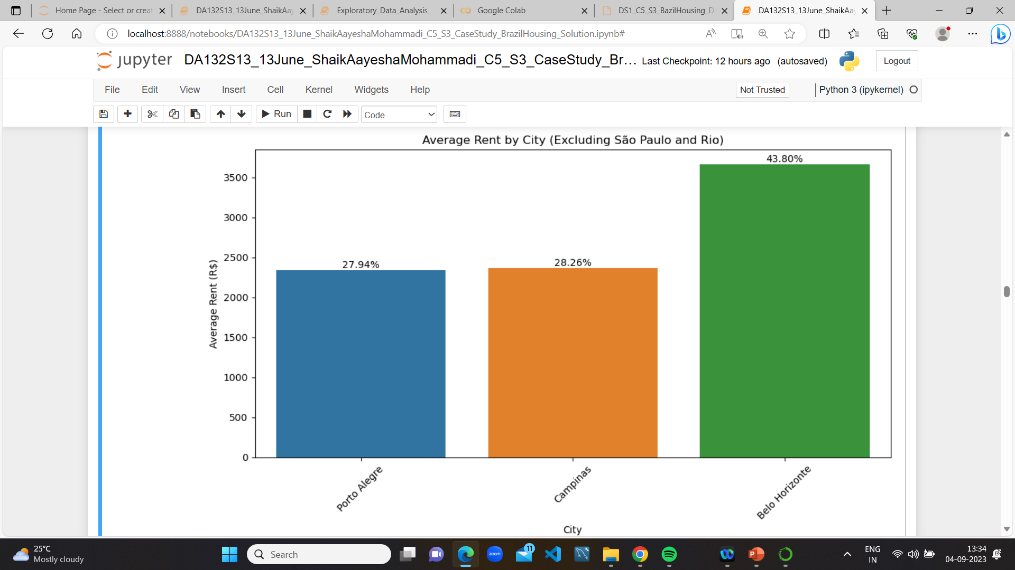
4) What is the Average Rent by City?
Porto Alegre collects less rent when compared to Campinas and Belo Horizonte

Slide 12
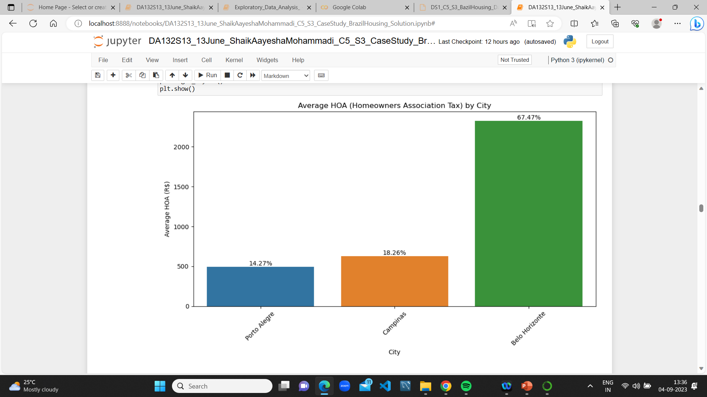
5) What is the Average HOA (Homeowners Association Tax) by City?
Porto Alegre collects less HOA(Homeowners Association Tax) when compared to Campinas and Belo Horizonte

Slide 13
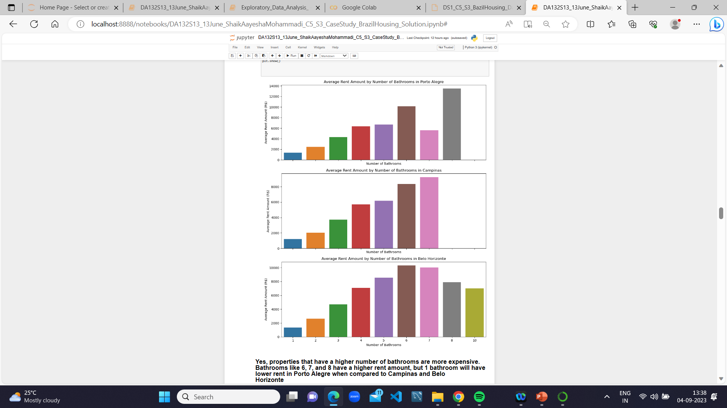
6) Do the count of bathrooms impact the average rent amount city-wise?
Yes, properties that have a higher number of bathrooms are more expensive. Bathrooms like 6, 7, and 8 have a higher rent amount, but 1 bathroom will have lower rent in Porto Alegre when compared to Campinas and Belo Horizonte

Slide 14
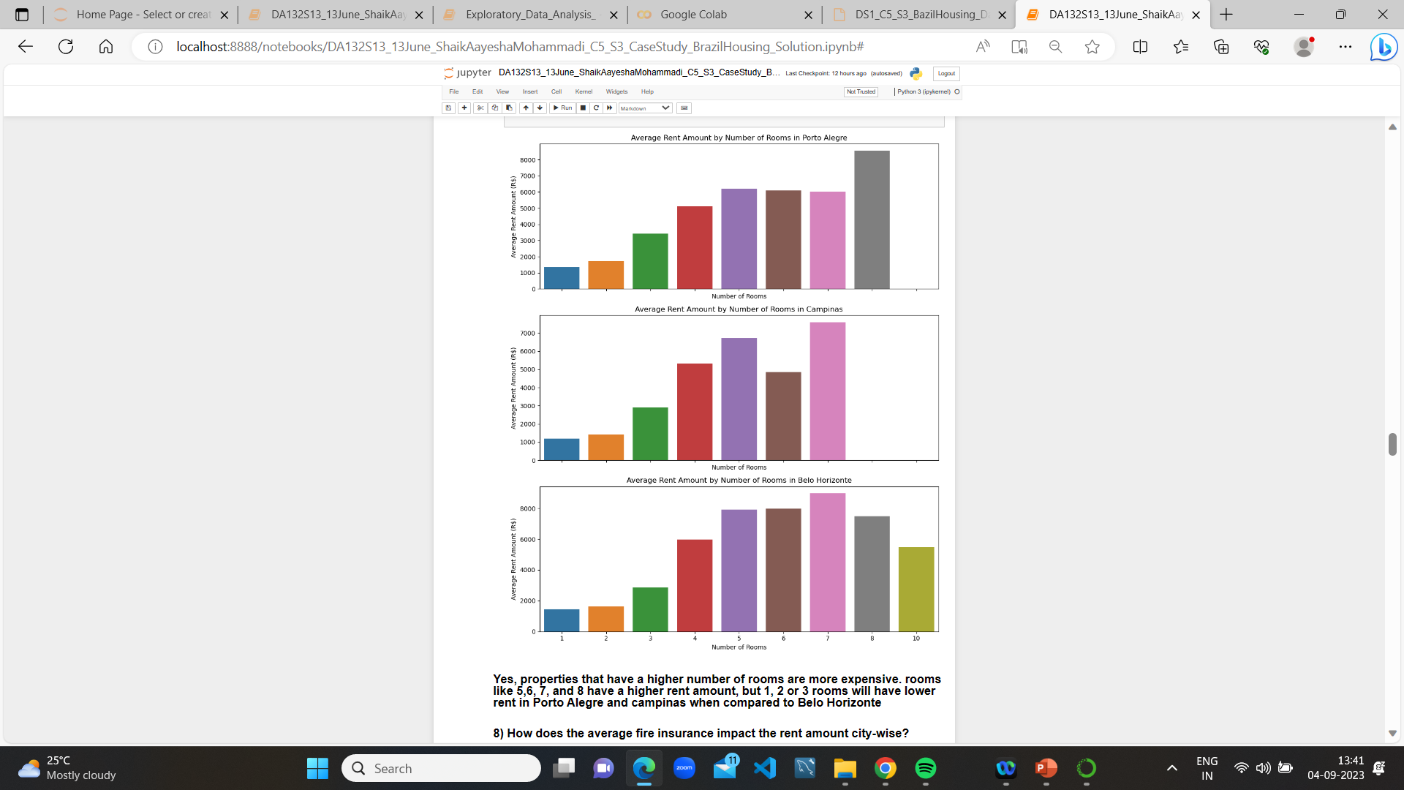
7)Do the count of rooms impact the average rent amount city-wise?
Yes, properties that have a higher number of rooms are more expensive. rooms like 5,6, 7, and 8 have a higher rent amount, but 1, 2 or 3 rooms will have lower rent in Porto Alegre and campinas when compared to Belo Horizonte

Slide 15
8) How does the average fire insurance impact the rent amount city-wise?
Yes, properties that have higher average fire insurance impact the rent, because the higher the rent, the higher the fire insurance.
Rent with 10k fire insurance is 140.

Slide 16
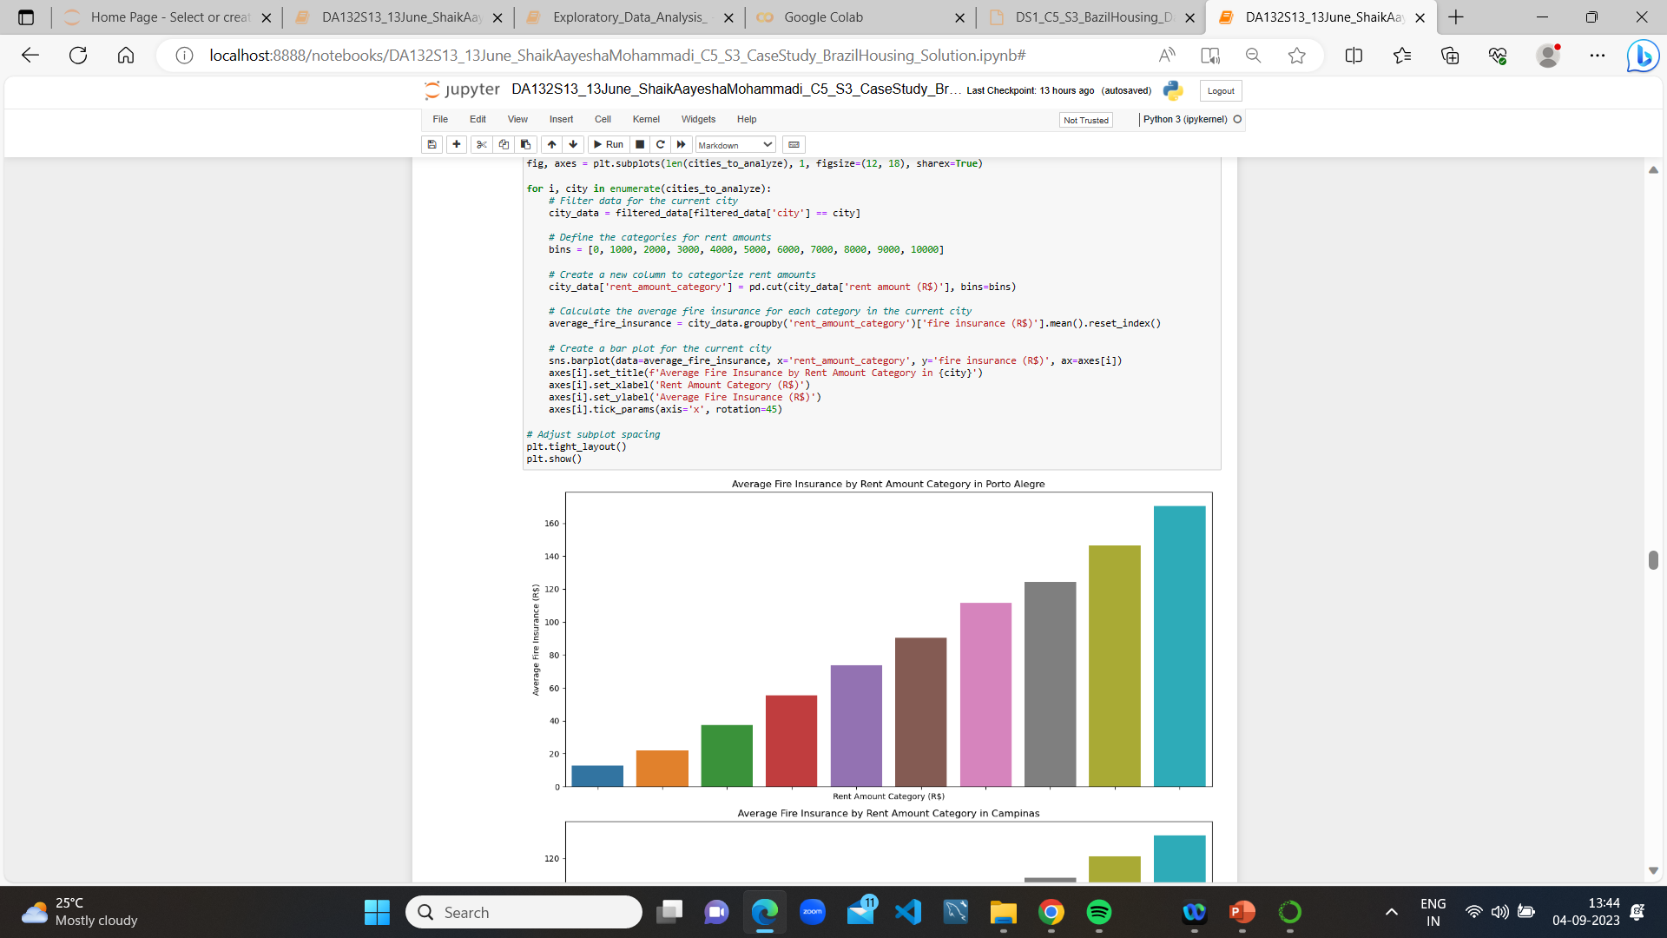
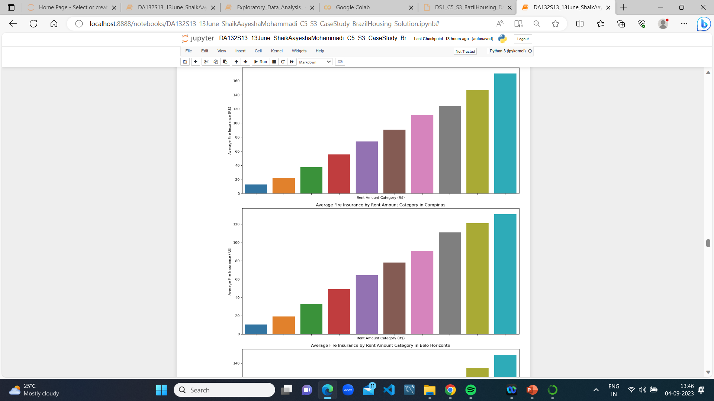
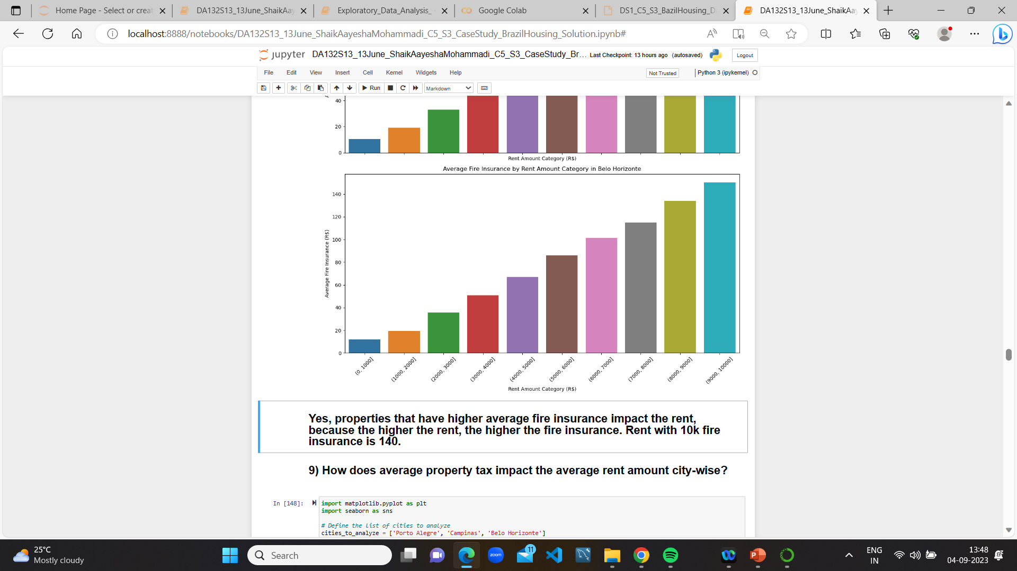

Slide 17
9) How does the average property tax impact the rent amount city-wise?
Yes, properties that have a higher average property tax impact the rent, because the higher the rent, the higher the property tax. Rent with 10k to 15k property tax is 1200. Lower the rent, lower the tax.
Campinas and Porto collect lower rent, which means lower average property tax.

Slide 18
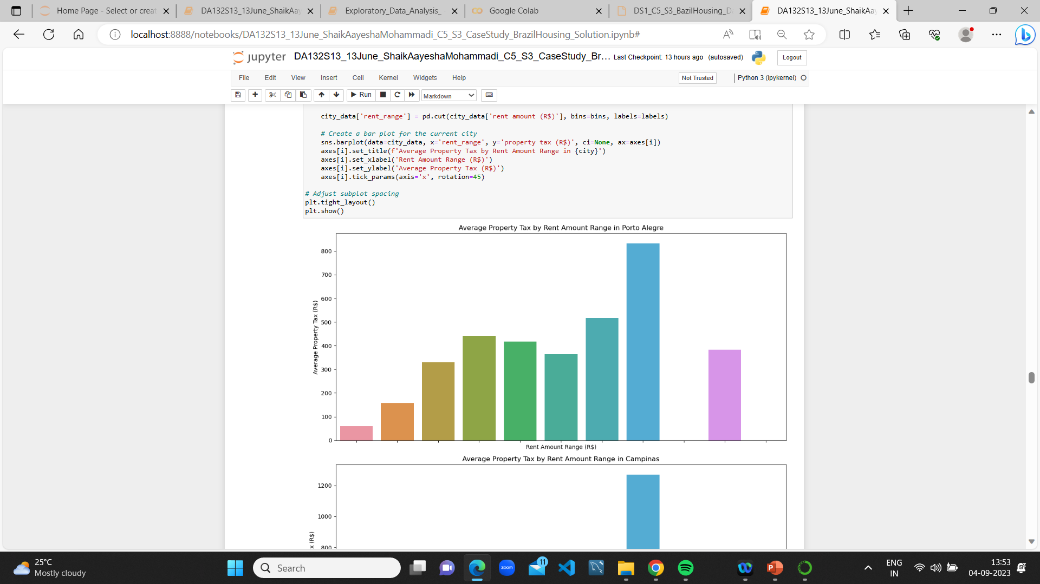
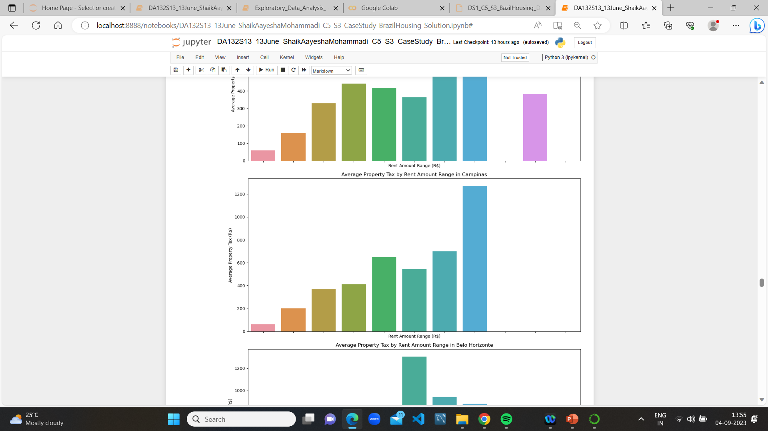
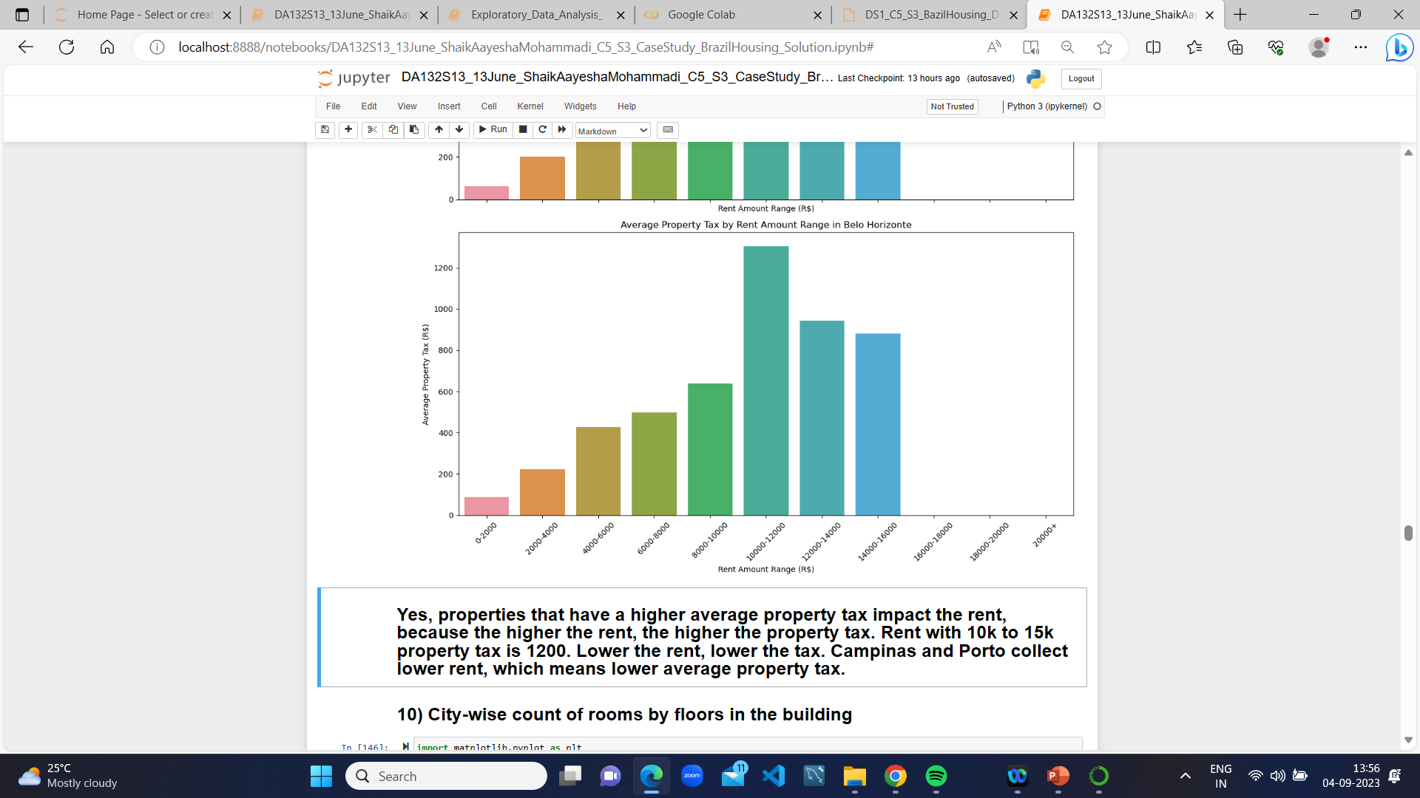

Slide 19
10) City-wise count of rooms by floors in the building.
Floors with 0, 1, 2, and 3, and the count of rooms are highest for Porto Alegre, Campinas, Belo Horizonte.

Slide 20
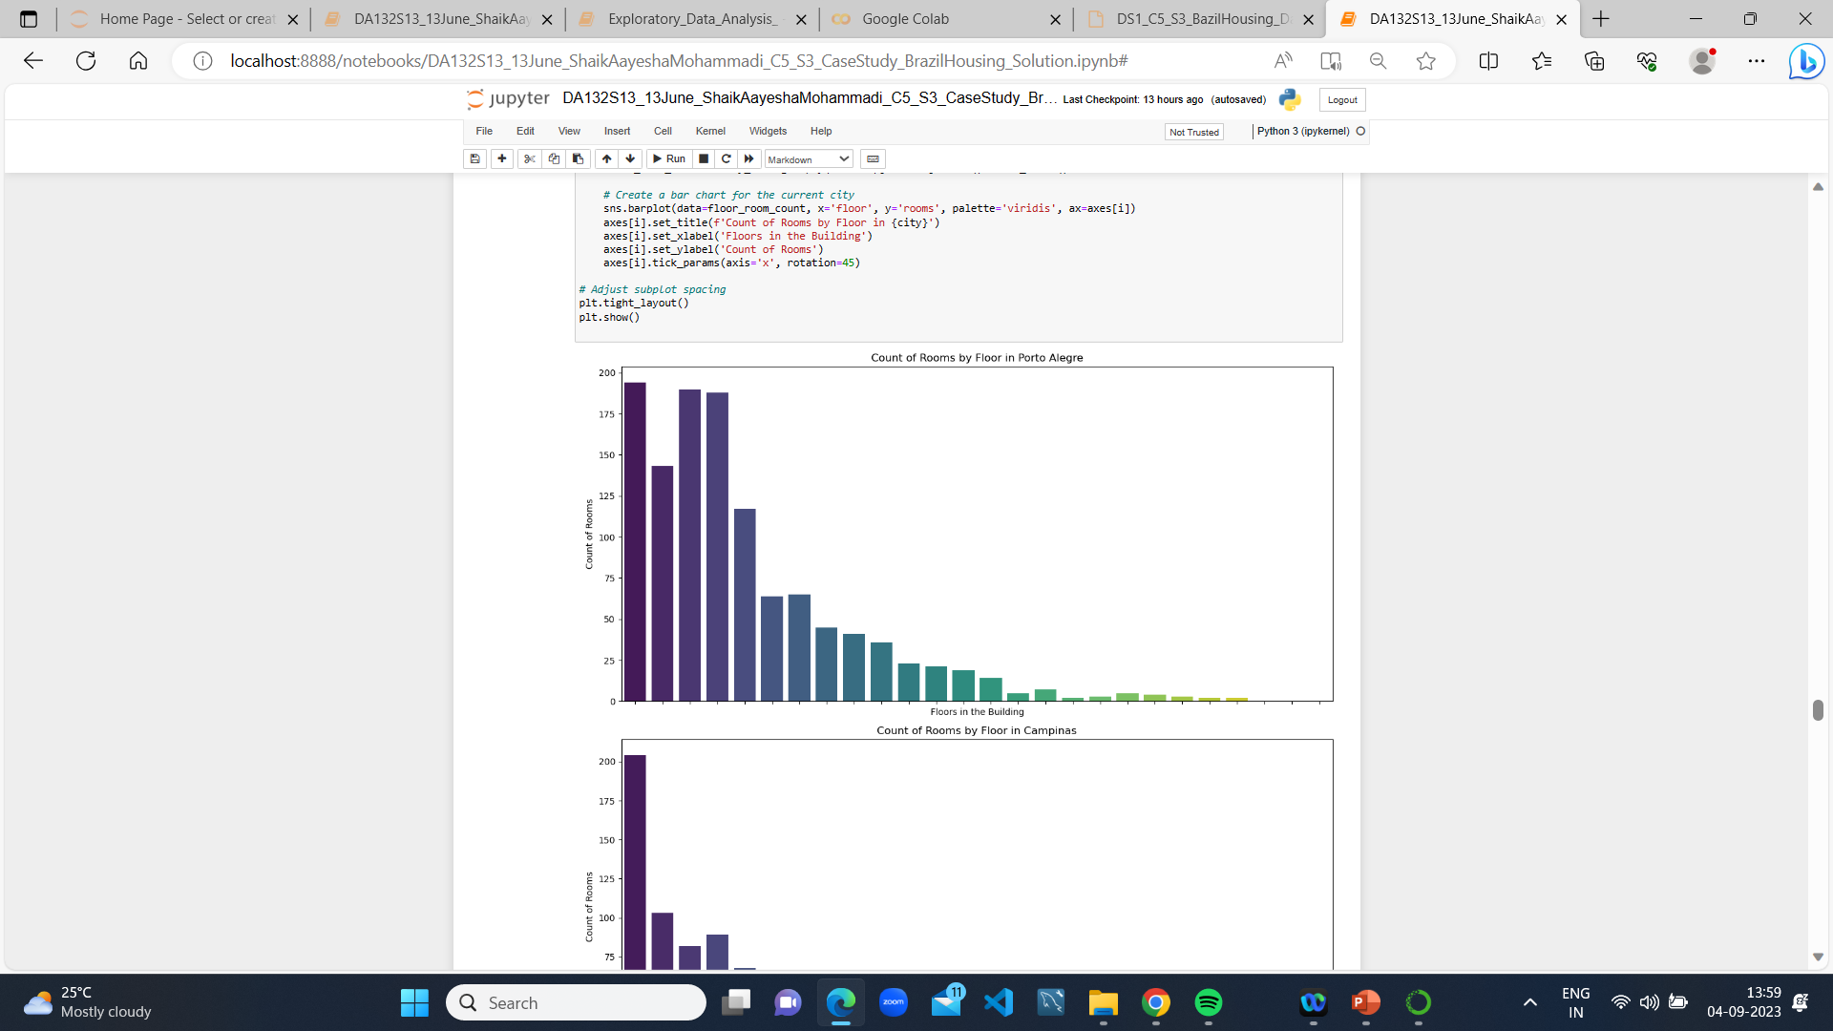
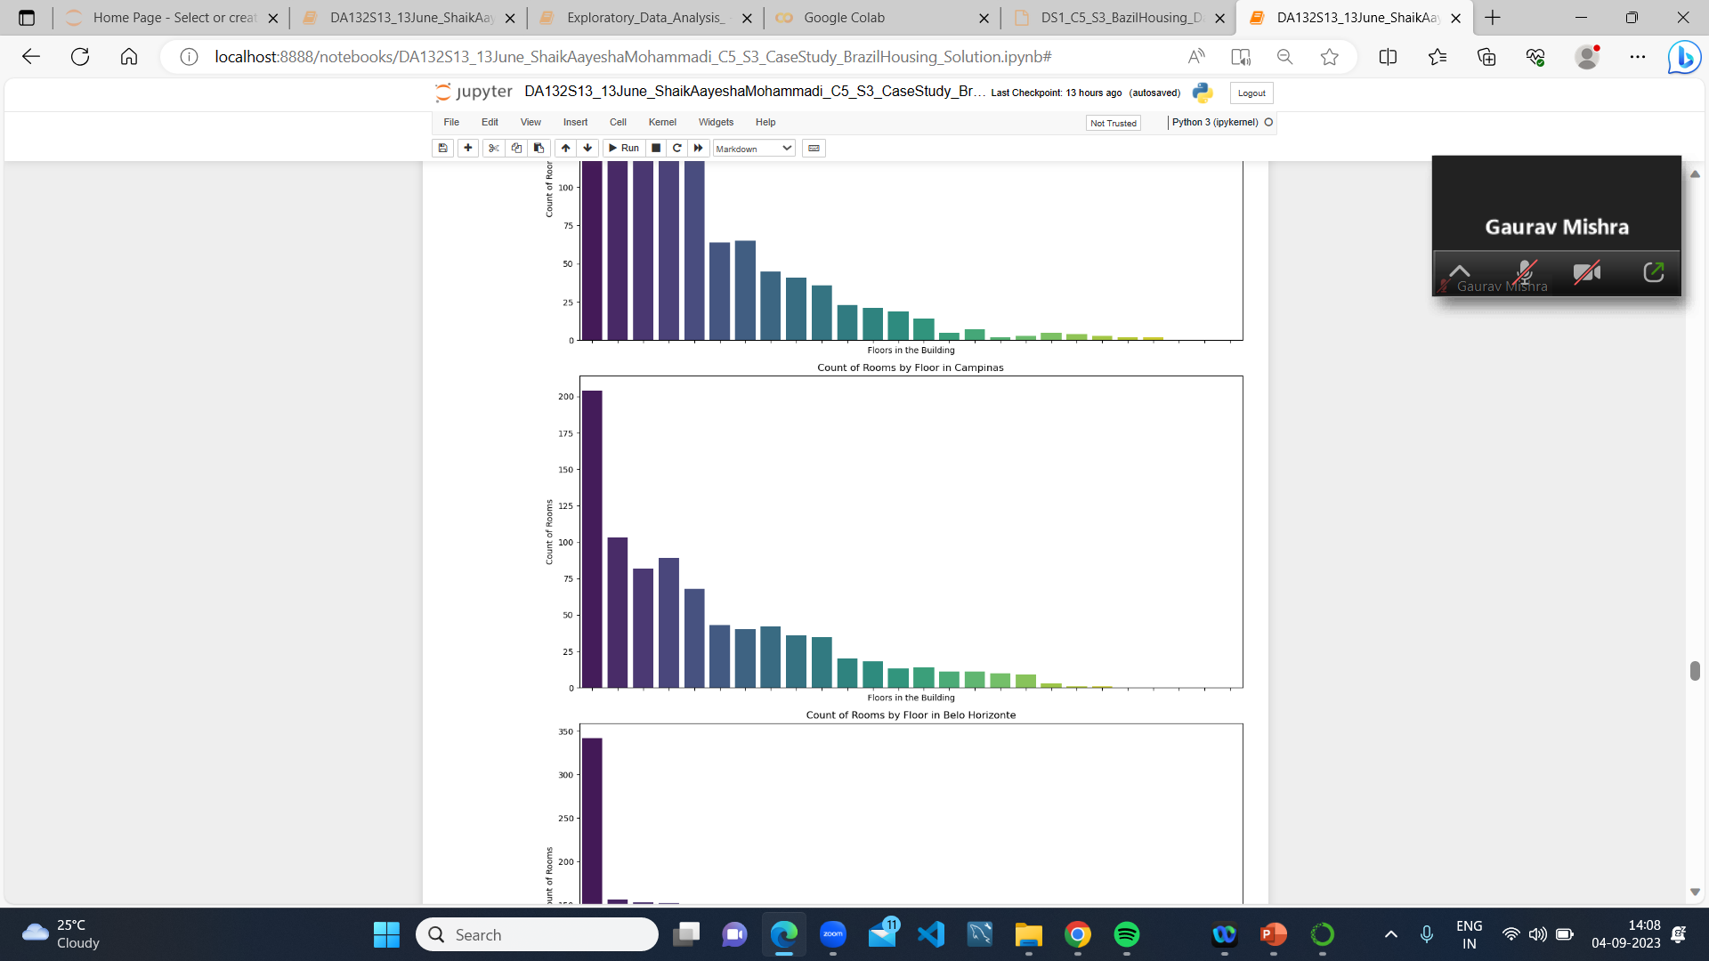
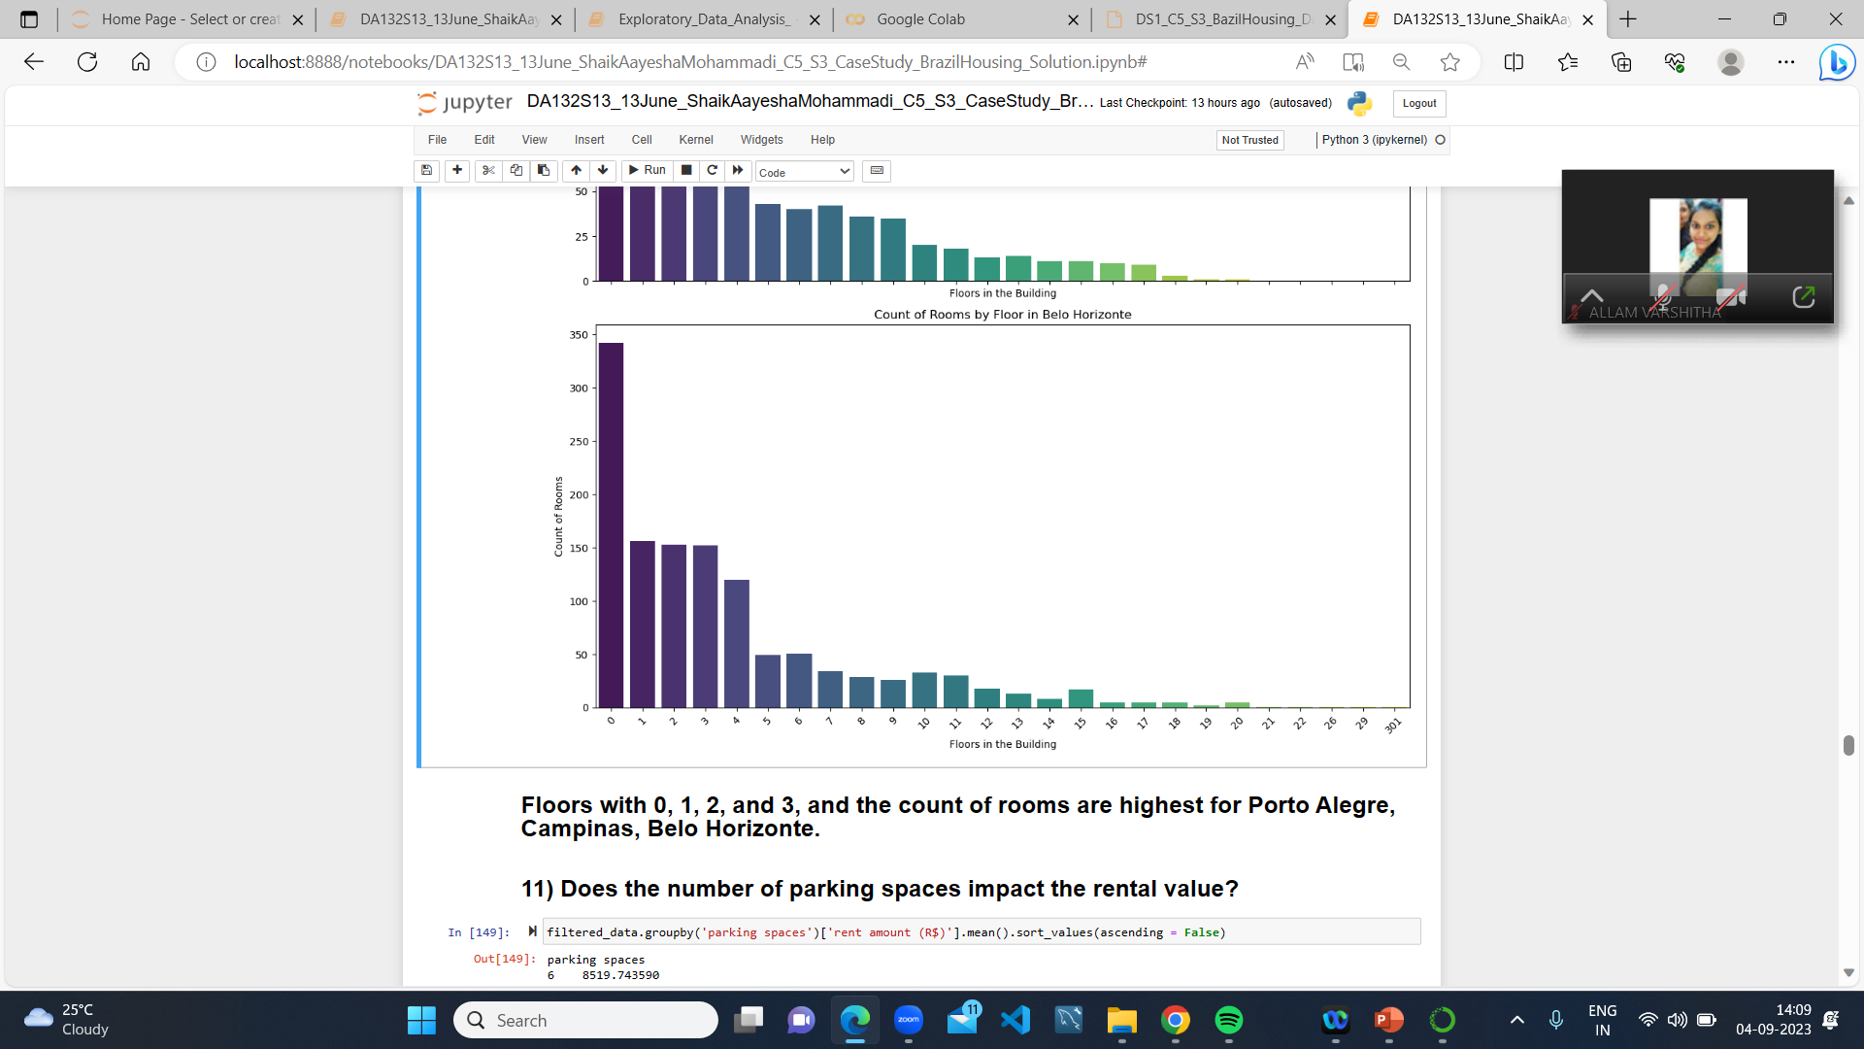

Slide 21
11) Does the number of parking spaces impact the rental value?
Yes, properties that have a higher number of parking spaces are more expensive.
Because the more parking spaces, the more the rent is impacted. Campinas and Porto, with 0 or 1 parking space, collect less rent compared to Belo Horizonte.

Slide 22
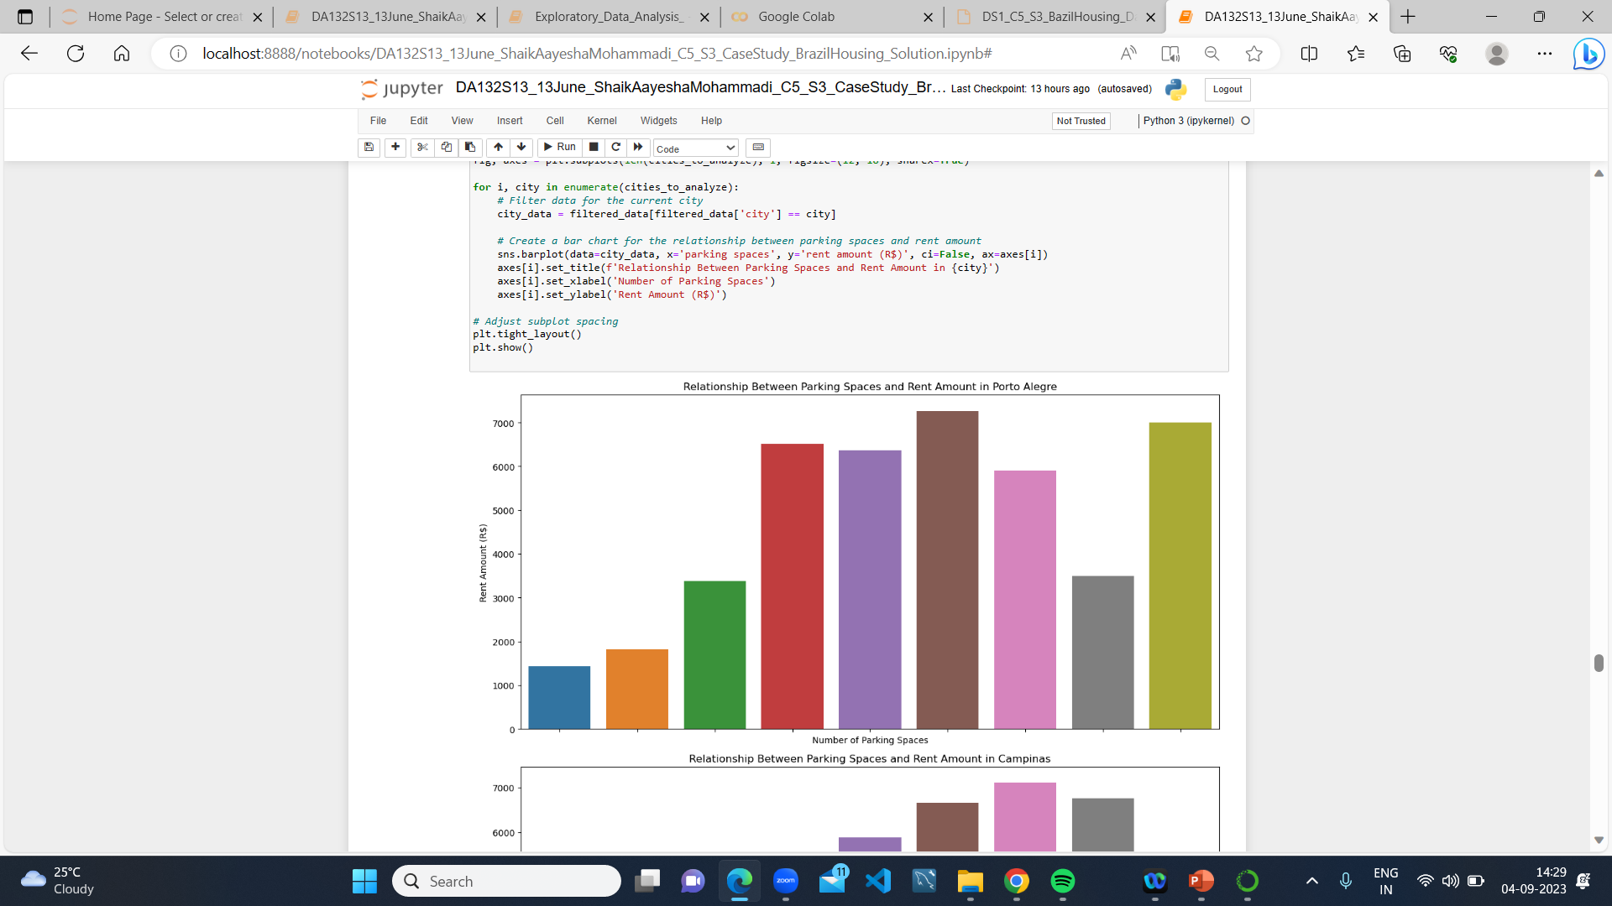
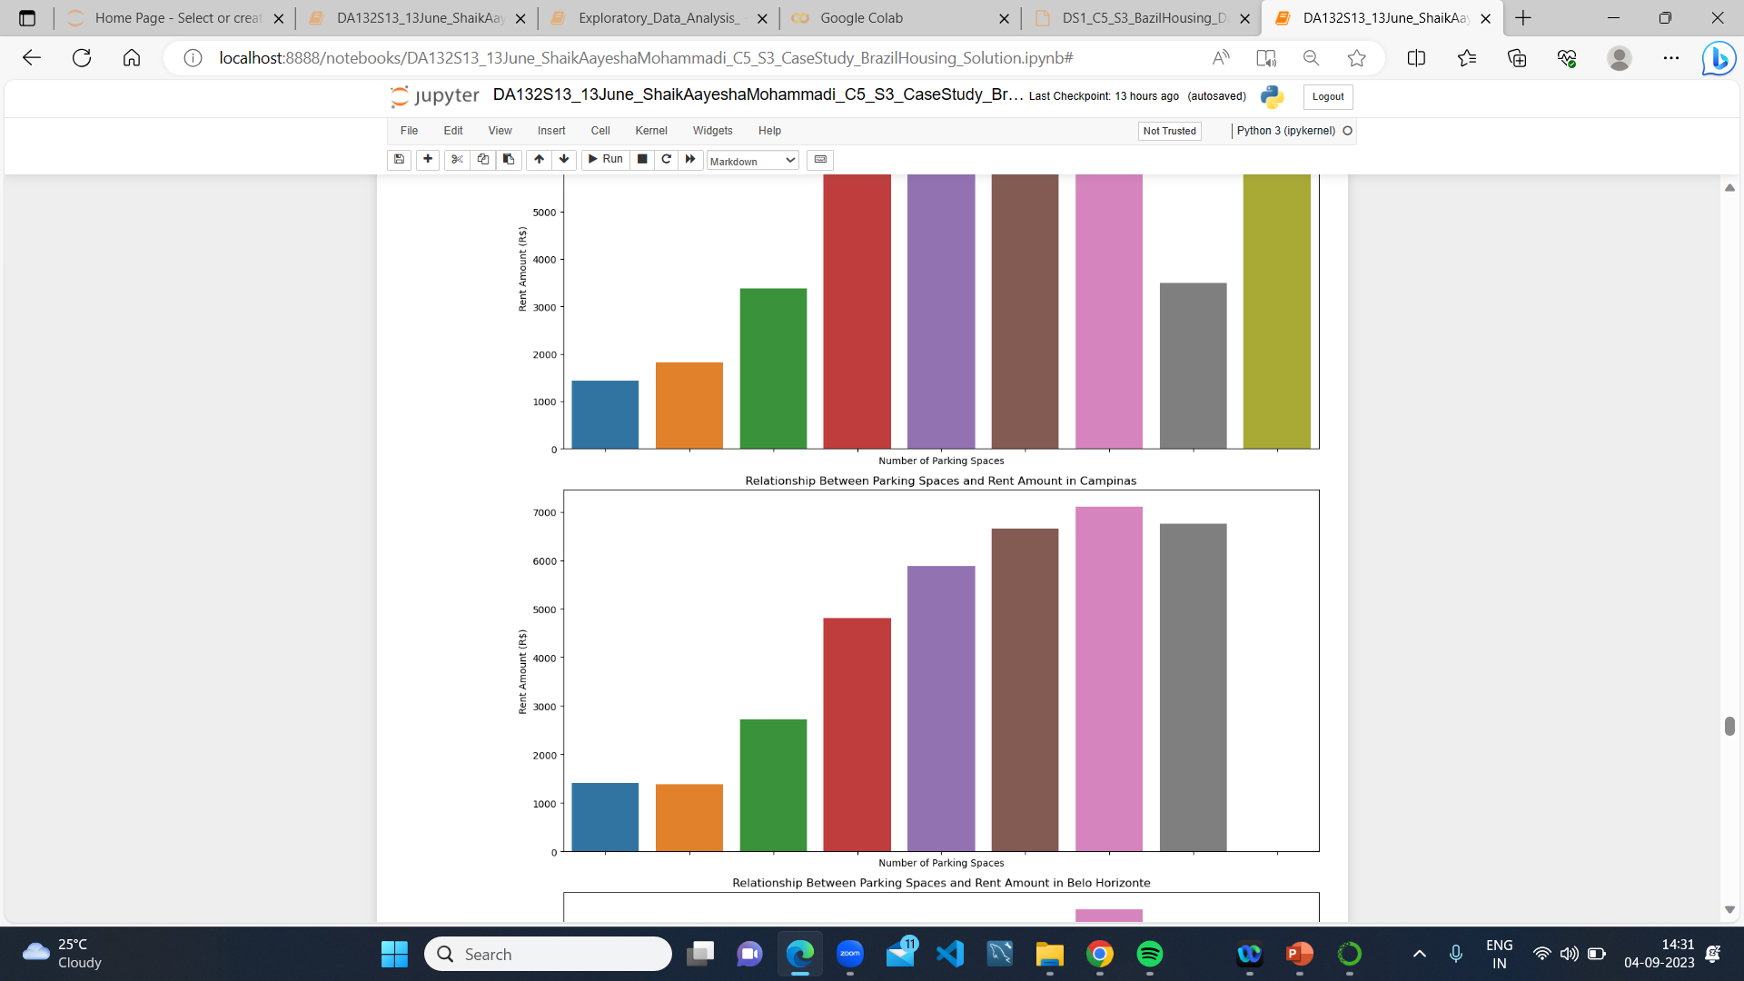
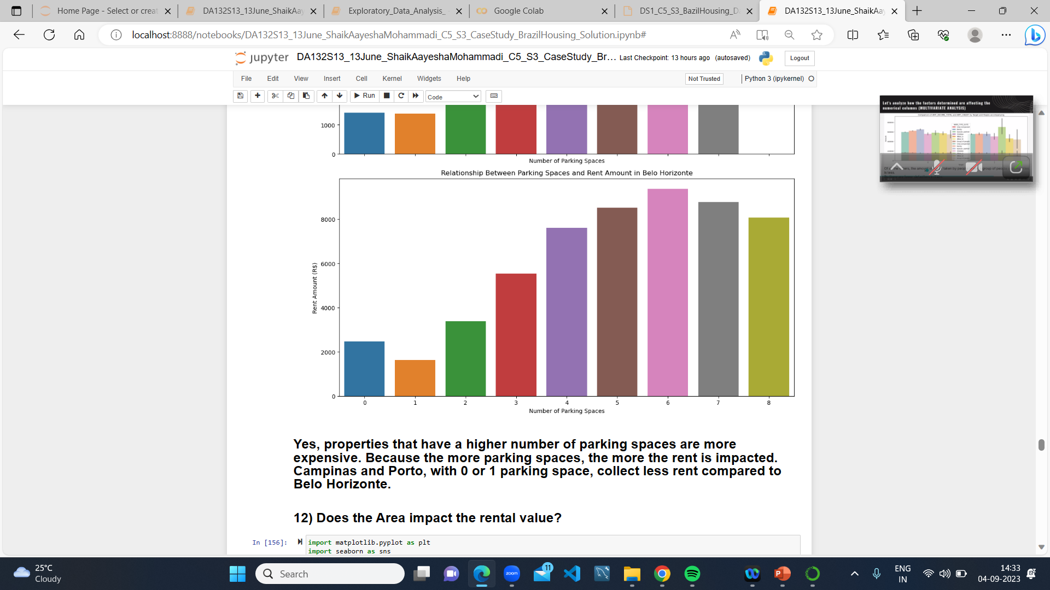

Slide 23
12) Does the Area impact the rental value?
Yes, properties that have a larger area are more expensive. Because the larger the area, the more the rent is impacted.
Campinas and Porto, with smaller areas, collect less rent compared to Belo Horizonte.

Slide 24
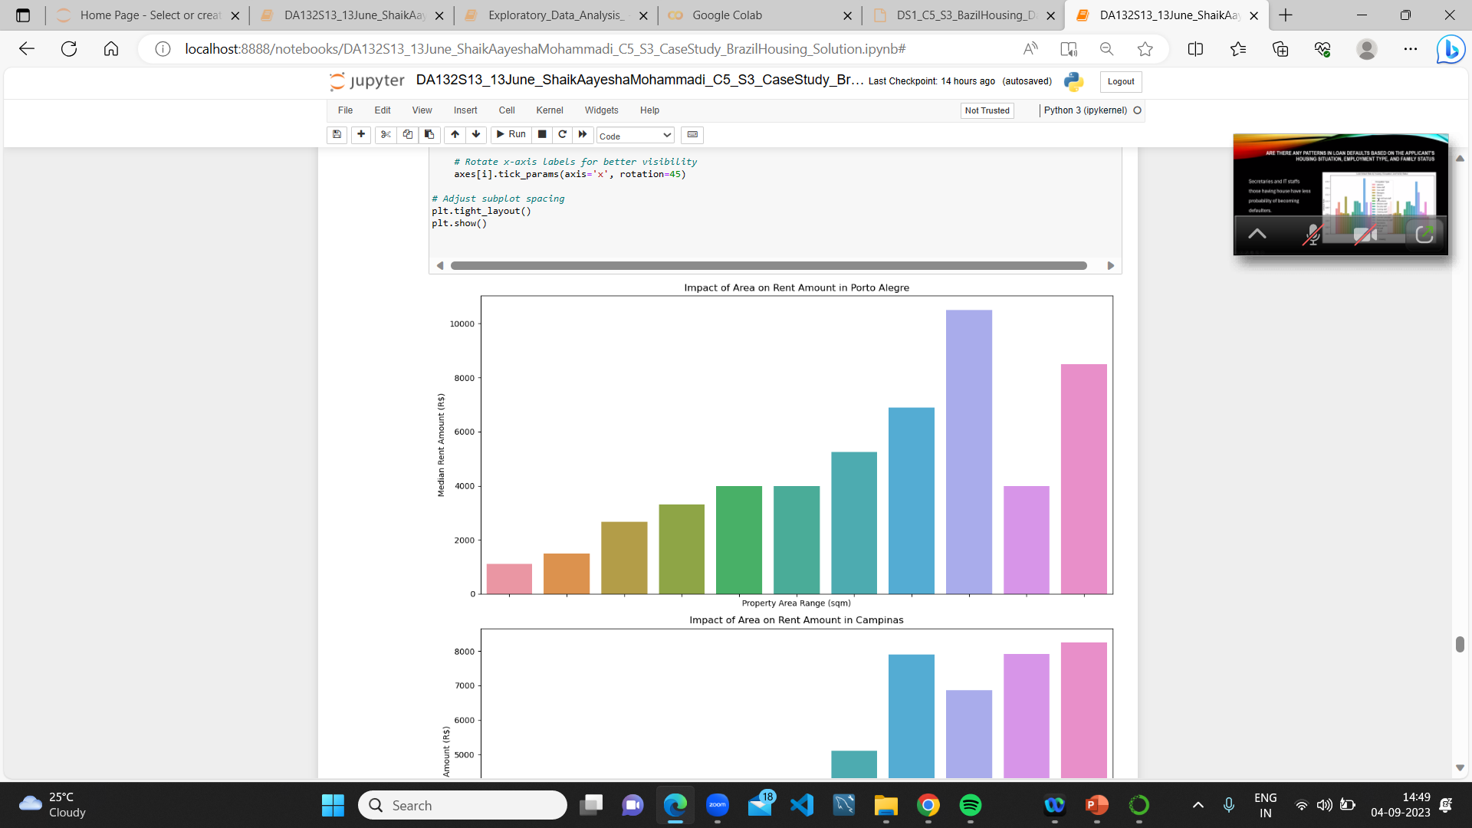
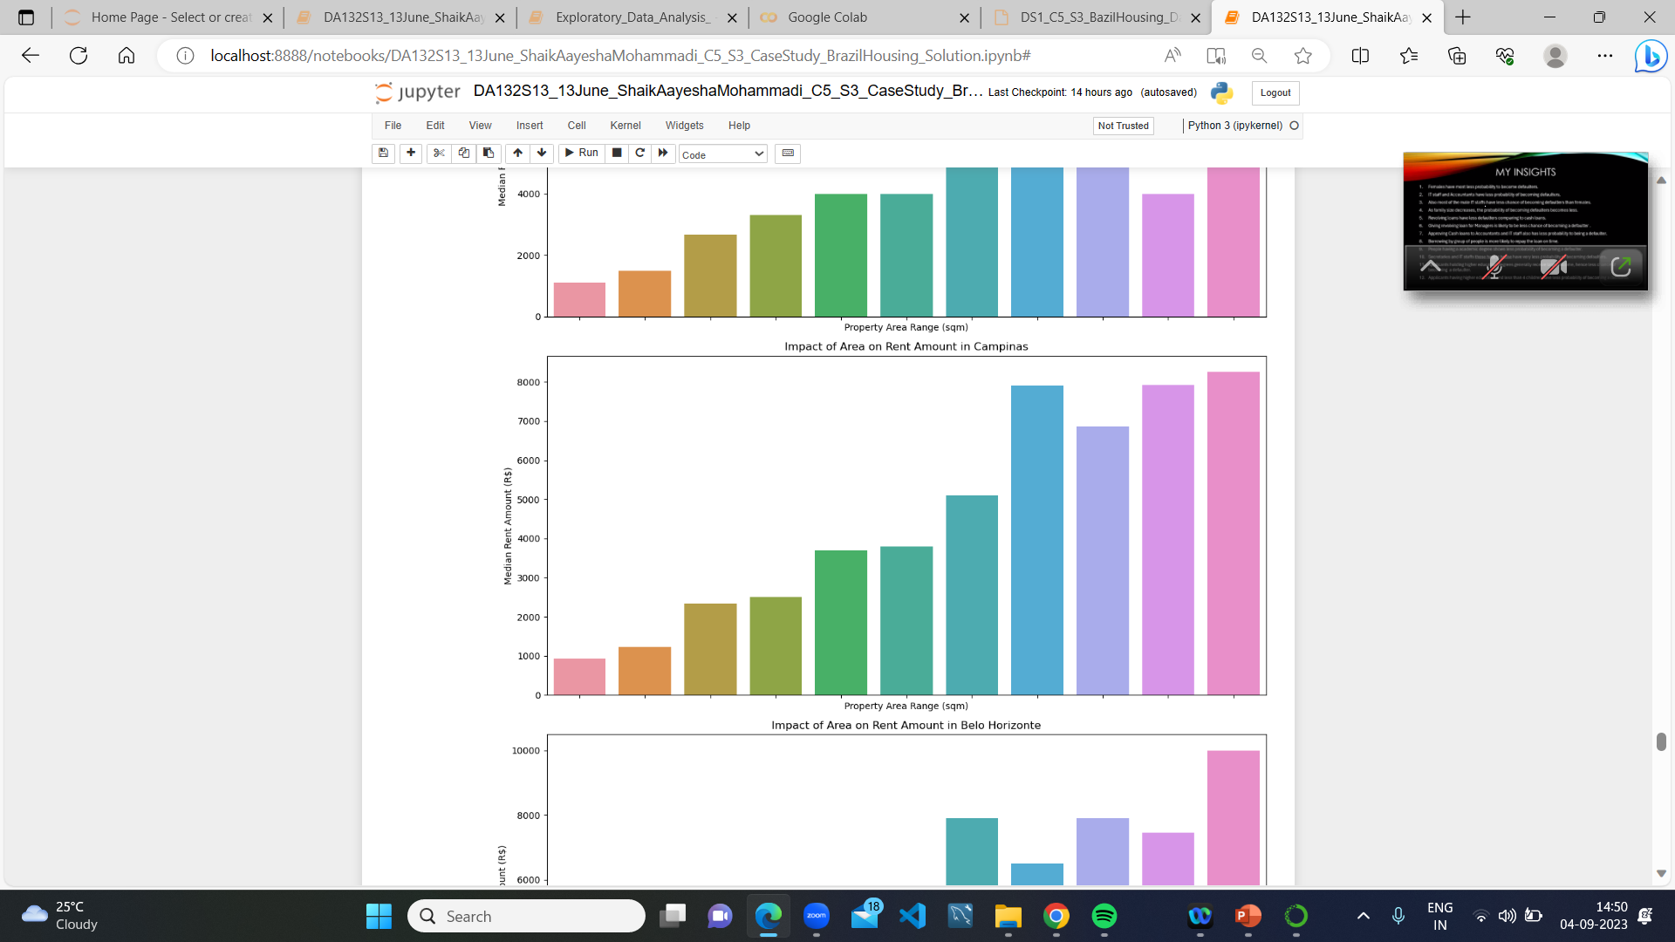
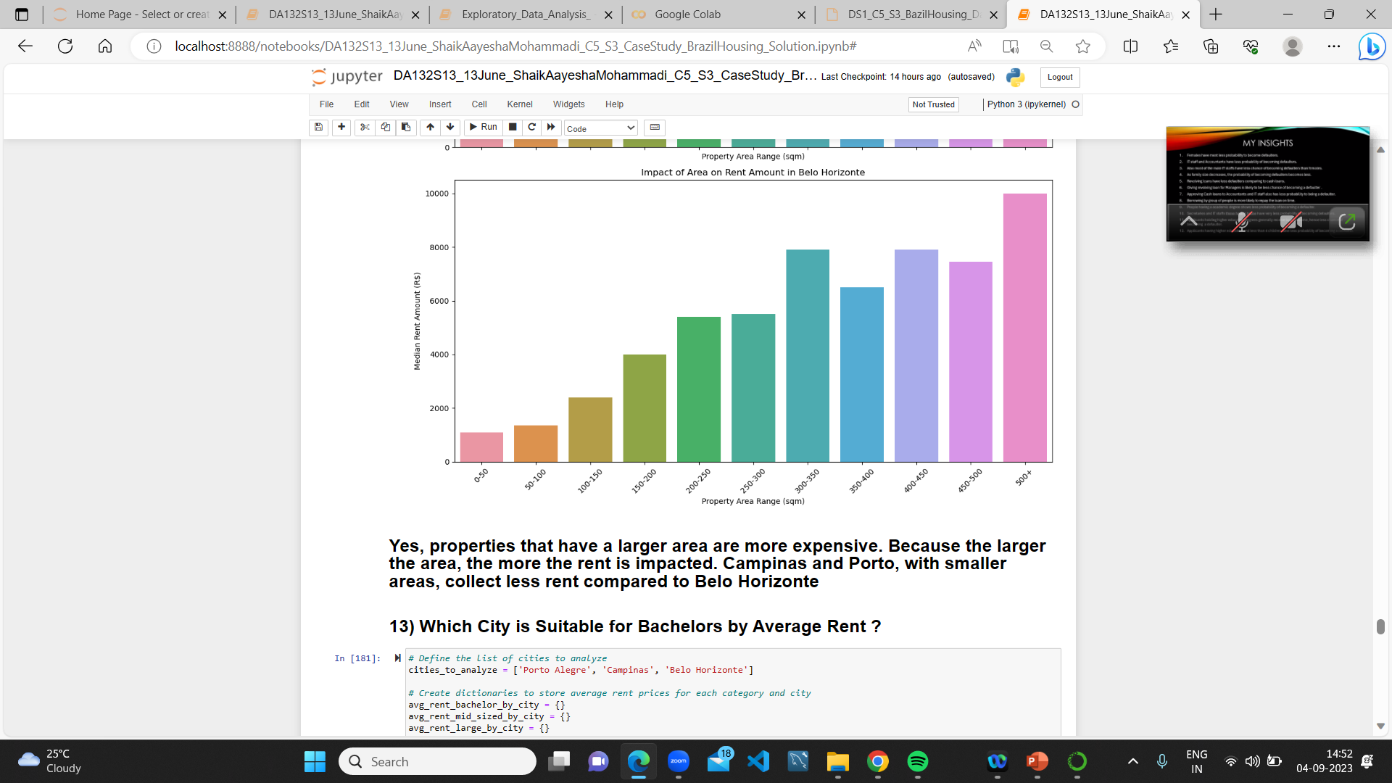

Slide 25
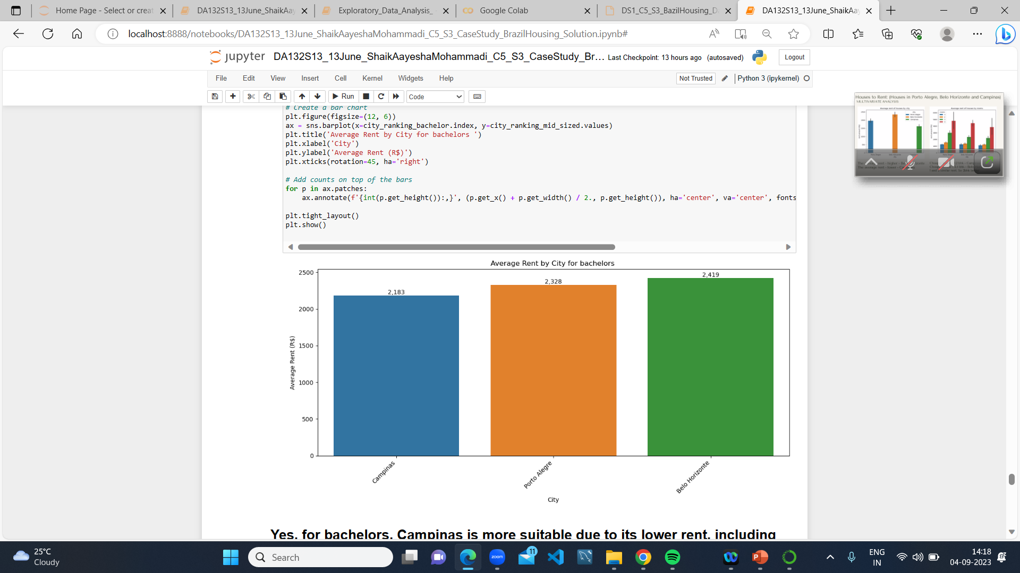
13) Which City is Suitable for Bachelors by Average Rent?
Yes, for bachelors, Campinas is more suitable due to its lower rent, including single-room and single-bathroom accommodations when compared to Porto and Belo Horizonte.

Slide 26
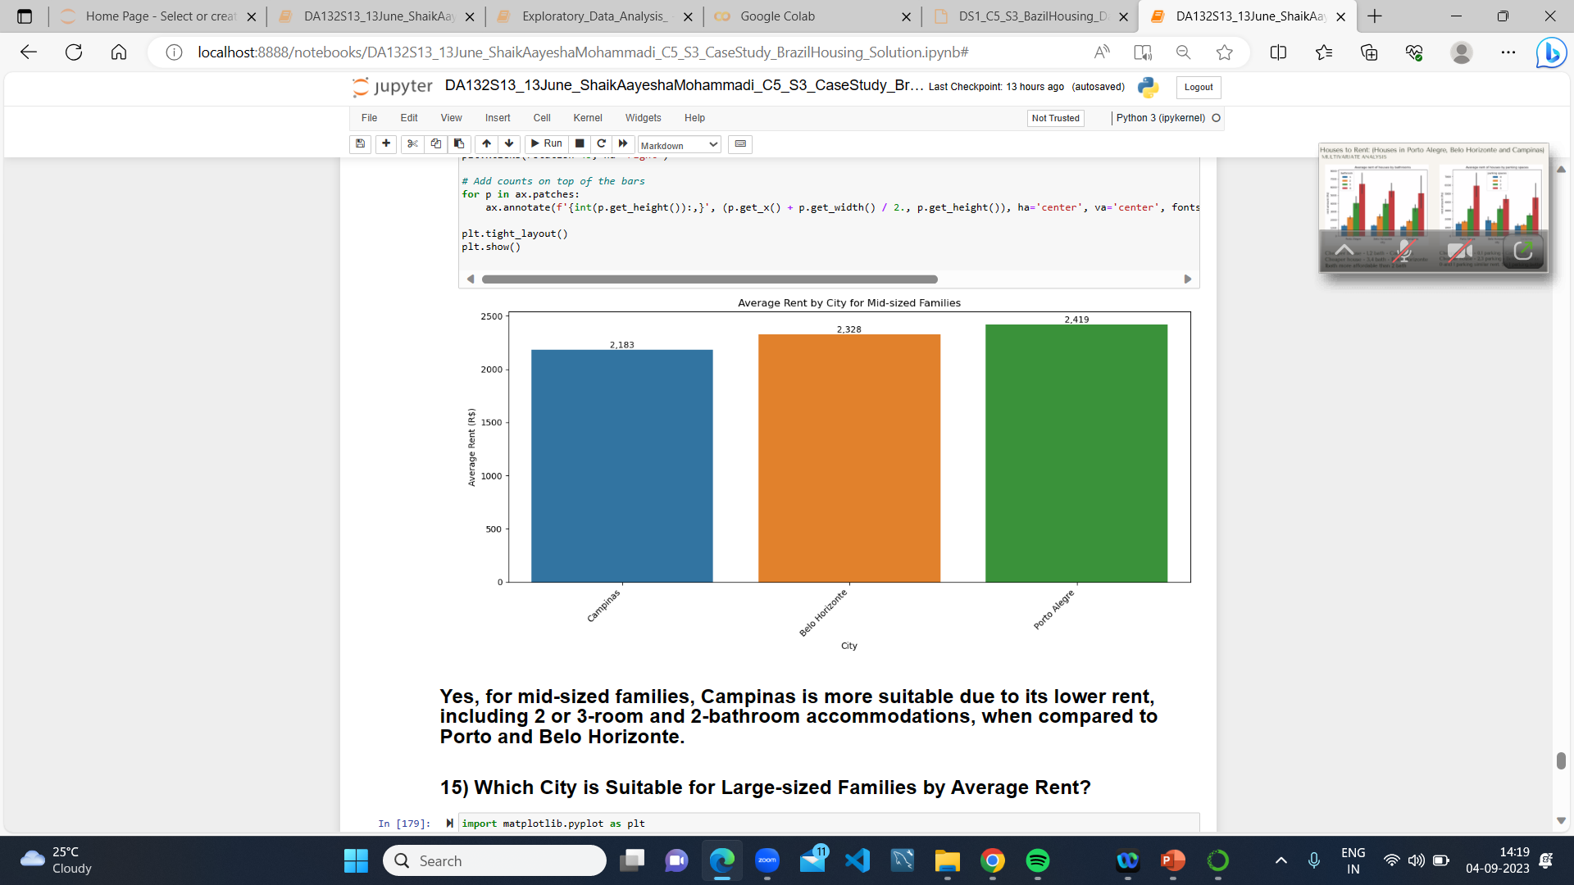
14) Which City is Suitable for mid-Sized Familes by Average Rent?
Yes, for mid-sized families, Campinas is more suitable due to its lower rent, including 2 or 3-room and 2-bathroom accommodations, when compared to Porto and Belo Horizonte.

Slide 27
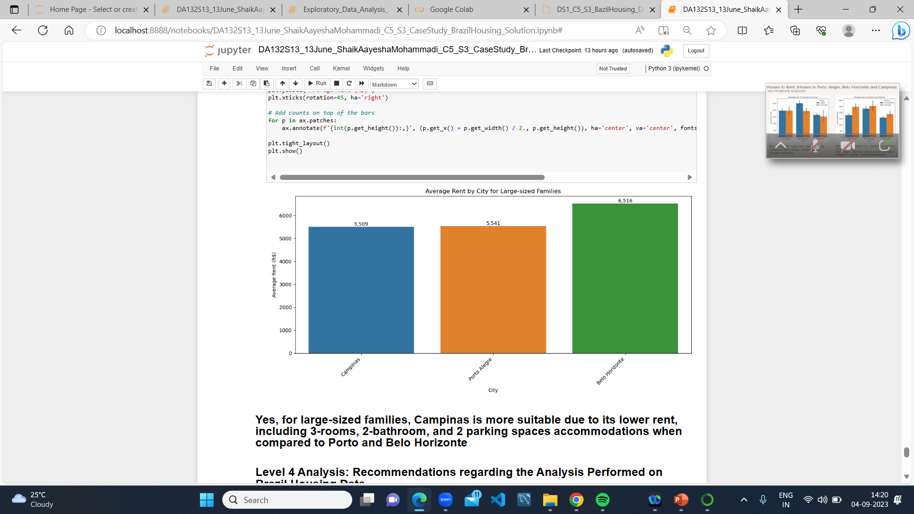
15) Which City is Suitable for Large-Sized Familes by Average Rent?
Yes, for large-sized families, Campinas is more suitable due to its lower rent, including 3-rooms, 2-bathroom, and 2 parking spaces accommodations when compared to Porto and Belo Horizonte

Slide 28
6) INSIGHTS
1) Campinas: Affordable rent for individuals and bachelors, especially for single-room accommodations.
2) Campinas: Good choice for mid-sized families with 2 or 3 rooms and 2 bathrooms.
3) Campinas: More affordable housing options for large-sized families with 3 rooms, 2 bathrooms, and 2 parking spaces.
4) Campinas and Porto Alegre: Lower property taxes compared to Belo Horizonte.
5) Belo Horizonte: Higher rent options around 2500, indicating a more pet-friendly environment.
6) Porto Alegre and Belo Horizonte: More options for furnished houses, but higher rent compared to Campinas.
7) Belo Horizonte: More parking space options.
8) Porto Alegre: Attractive for lower rent, especially for properties with 1 or 2 rooms.
9) Belo Horizonte: Larger area options, but at a higher cost.

Slide 29
ADVANTAGES
Informed Decision-Making
Trend Identification
Optimized Pricing
Resource Allocation
Risk Mitigation
Competitive advantage
Customized Marketing Strategies

Slide 30
DISADVANTAGES
Complexity and Expertise
Data Quality Issues
Changing Market Dynamics
Limited Scope

Slide 31
APPLICATIONS
Housing Market Reports
Property Valuation
Risk Assessment for Lenders
Forecasting Housing Trends

Slide 32
CONCLUSION
The choice of city for relocation from São Paulo or Rio depends on individual preferences, budget, and family size. Campinas is a well-rounded option for those seeking affordability and flexibility in property choices. Porto Alegre is a budget-friendly choice, especially for smaller households.
Belo Horizonte caters to individuals or families with higher budgets and a preference for larger, more upscale properties. Each city offers its unique advantages, and a careful assessment of personal needs is crucial when making the decision to move.
Choose based on your budget and room requirements as the analysis provide User-friendly features enhance accessibility for budget-friendly options.

Slide 33
THANK YOU

